Slide 1
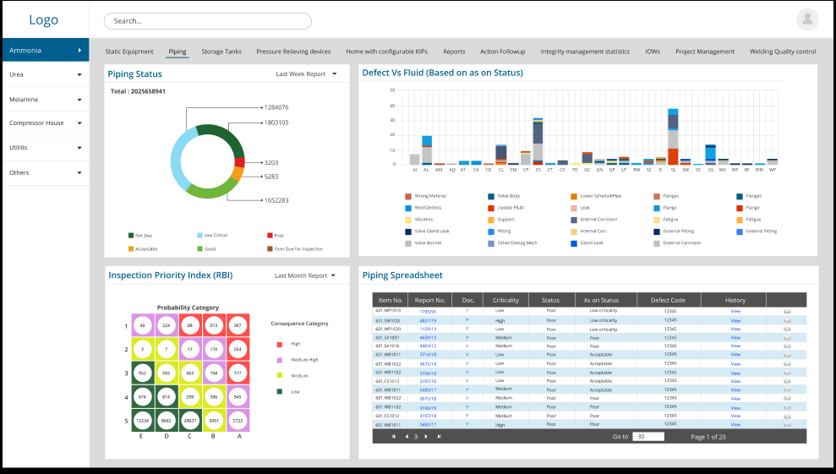
The basic screen (Plant upto - fluid level)
Please note that the chart should not show here the number of reports. It should show only number of Pipe Lines (Pipe master table)
Interactive to filter data
Reports Menu
Piping
POF
COF
TML
All the three charts should be interactive and if any of the chart is clicked, then all the remaining charts including the piping spread sheet should filter out and show only the pipe lines in that criteria.
Also as discussed the bottom right menu should show reports of the filtered pipe lines.

